Slide 1


SAFETY ANALYSIS DATA FOR AIRCRAFTS.
Caroline Wambui Kimani
Date: 26th September 2024

Slide 2

AIRCRAFT SAFETY ANALYSIS FOR BUSINESS DECISION
Identifying low risk Aircraft for Acquisition.

Slide 3

Overview.
PURPOSE
Analyze aviation accident data to guide business decisions on aircraft acquisitions.
GOALS
- Identify low-risk aircraft models based on historical data.
- Understand the safety factors that influence accident outcomes.
- Provide recommendations for safer aircraft choices in our fleet.

Slide 4

BUSINESS UNDERSTANDING
CONTEXT
The company is expanding into aviation and needs to assess the
potential risks related to different aircraft models.
KEY QUESTIONS
- Which aircraft models present the least risk?
- What are the main causes of aviation accidents?
- How can our business mitigate these risks during acquisition?
.

Slide 5
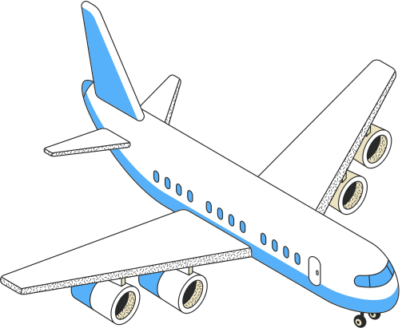
DATA UNDERSTANDING
Data Source : National Transportation Safety Board (1962-2023).
Key Features:
Rates of injury, aircraft types, accident causes, weather conditions.
Dataset Size:
Covers over 60 years of aviation data with key columns like injury severity, aircraft make, and weather.

Slide 6

DATA ANALYSIS
Methodology:
- Analyzed accident severity and number of uninjured passengers by aircraft make.
- Calculated the ratio of fatalities to aircraft make.
- Identified top 10 aircraft makes by frequency.
- Applied normalization techniques to assess distribution errors across all makes.

Slide 7
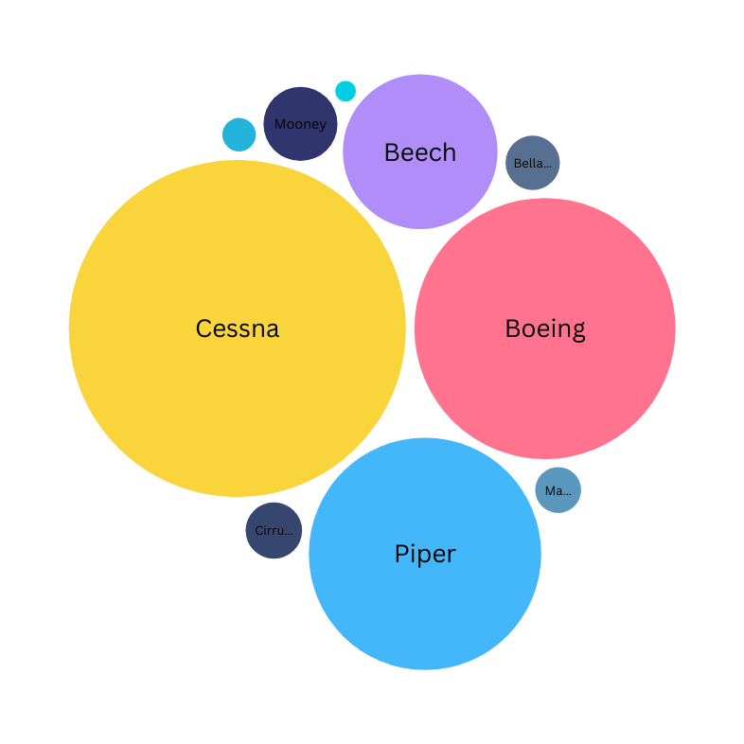
Title: Rate of Aircraft Uninjured
DESCRIPTION
This graph shows the rate at which passengers remained uninjured across different aircraft models.
INSIGHT
Cessna has the highest uninjured ratio at *134.70, followed by Boeing at **80.84, indicating better safety outcomes. Piper's ratio of **64.01* shows potential for improvement. In comparison, Beech (28.38) and smaller manufacturers like
Mooney (6.5) and Cirrus Design Corp (3.78) present greater risks. This data emphasizes the need to prioritize aircraft with higher uninjured ratios, such as Cessna and Boeing, for safer operations in our company.
Packed Circle Graph

Slide 8
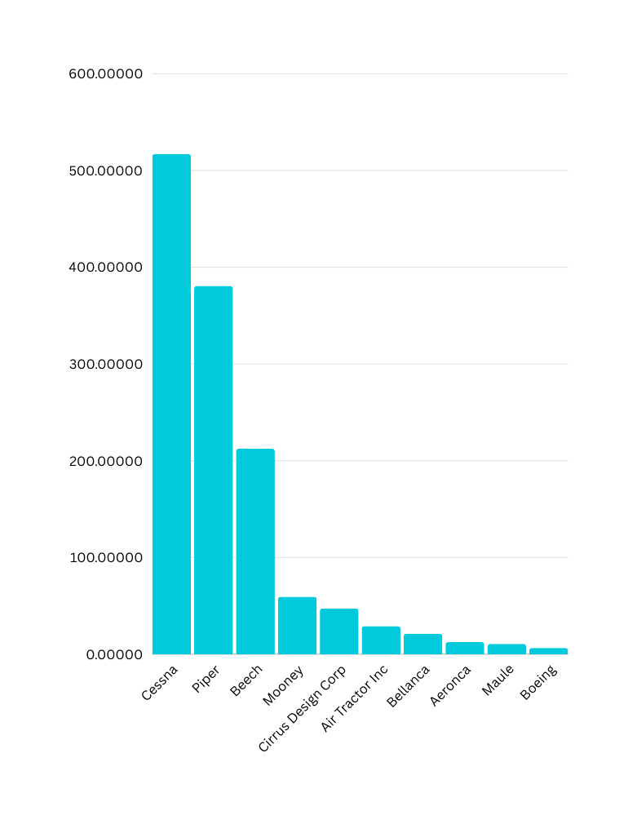
TITLE: RATIO OF FATALITIES BY AIRCRAFT MAKE
DESCRIPTION
A comparative view of the fatalities-to-passengers ratio for each aircraft make.
INSIGHT
Cessna and Piper also lead in fatalities, with Cessna at 517 and Piper at 381. These makes show significantly higher fatality counts, highlighting a potential safety concern compared to other aircraft like Boeing, which has only 6.
Bar Graph

Slide 9
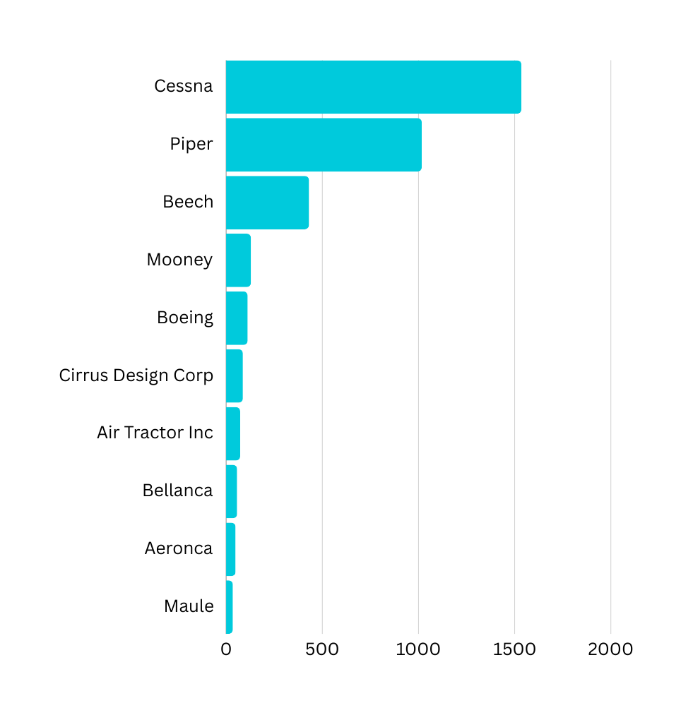
TITLE:TOP 10 AIRCRAFT BY MAKE
DESCRIPTION
A ranking of the top 10 most frequently mentioned aircraft by make.
INSIGHT
Cessna and Piper have the highest number of accidents, with Cessna leading at 1,535 and Piper at 1,017. These makes stand out as having significantly more accidents compared to others, suggesting they may require further safety review.
Row Chart

Slide 10
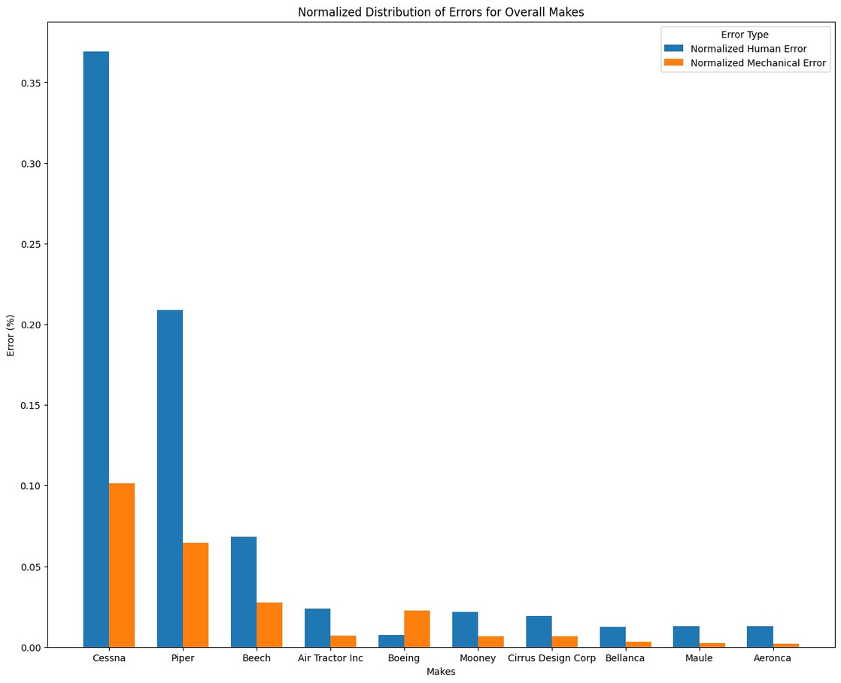
TITLE:NORMALIZED DISTRIBUTION ERRORS ACROSS AIRCRAFT MAKES.
DESCRIPTION
A normalized view of distribution errors for different aircraft makes, showing deviation in safety performance.
INSIGHT
HUMAN AND MECHANICAL ERROR ANALYSIS
CESSNA'S HIGH ERROR RATES: CESSNA SHOWS THE HIGHEST HUMAN AND MECHANICAL ERRORS, LINKING TO ITS TOP ACCIDENT COUNT AND SUGGESTING SAFETY ISSUES.
BOEING'S MECHANICAL ERROR TREND: BOEING HAS MORE MECHANICAL ERRORS THAN HUMAN ERRORS. FURTHER ANALYSIS WILL IDENTIFY THE SPECIFIC MODELS INVOLVED.
Bar Graph

Slide 11
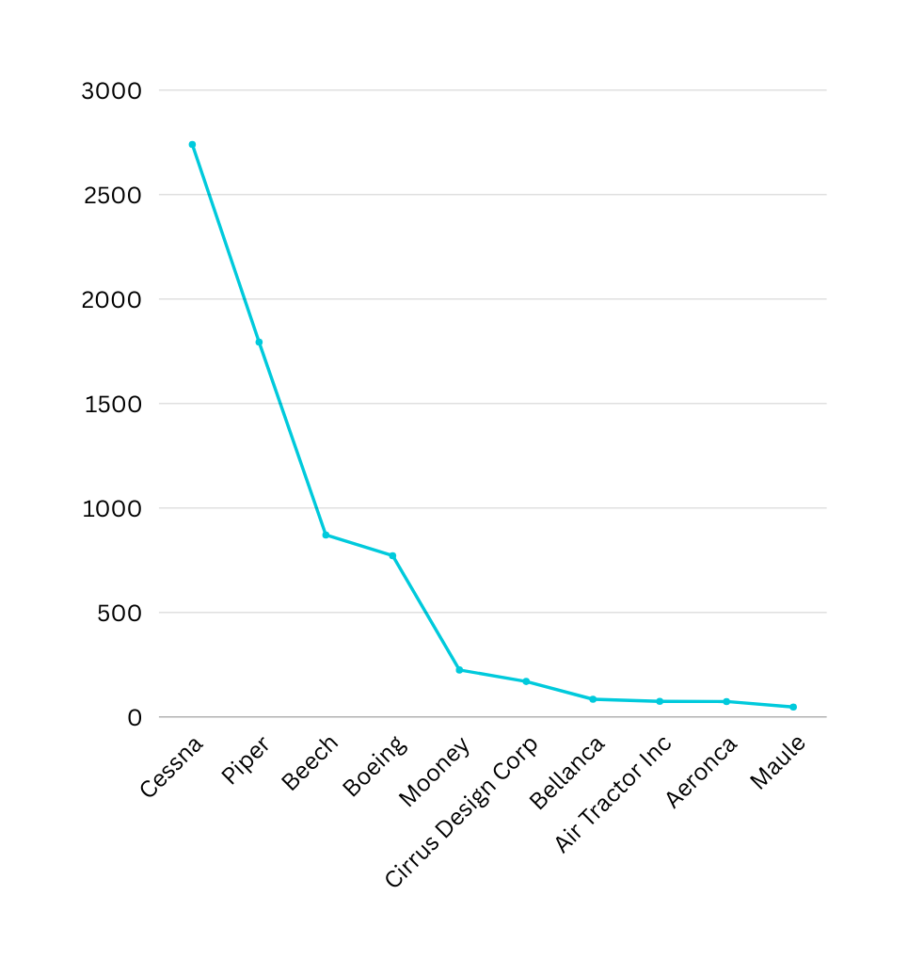
TITLE: AIRCRAFT MAKE BY TOTAL AFFECTED PASSENGERS
DESCRIPTION
Displays the total number of affected passengers (injuries and uninjured) for each aircraft make.
INSIGHT
CESSNA AND PIPER DOMINATE IN TOTAL AFFECTED PASSENGERS, WITH CESSNA AT 2,740 AND PIPER AT 1,794. THIS SIGNIFICANT DISPARITY SUGGESTS SERIOUS SAFETY CONCERNS FOR THESE AIRCRAFT, ESPECIALLY COMPARED TO BOEING, WHICH HAS ONLY 772 AFFECTED PASSENGERS.
Line Chart

Slide 12
RECOMMENDATIONS
Recommendation 1
Focus on aircraft makes with a higher rate of uninjured passengers.
Recommendation 2
Avoid aircraft makes that consistently show higher fatality-to-passenger ratios.
Recommendation 3
Prioritize the top-performing aircraft models based on normalized distribution error analysis and overall safety performance.

Slide 13
CONCLUSION SUMMARY
Risk of Personal Injury Summary
This analysis examined passenger injuries in adverse events from 2008 to 2022, focusing on minor injuries, serious injuries, and fatalities. Key findings include:
1. Total Number of Injuries: Cessna had the highest injury count, while Maule had the lowest.
2. Fatalities Analysis: Cirrus Design Corp. exhibited the highest fatality-to-injury ratio, indicating greater fatality risk, whereas Boeing had the lowest ratio, making it the safest in terms of fatalities.
3. Uninjured Passenger Ratio: Boeing also had the highest uninjured passenger ratio, signifying better overall safety, while Mooney had the lowest.
Recommendation
- Avoid investing in Cessna due to high injury rates.
- Consider evaluating Boeing and Maule, which showed lower injury and fatality rates, with Boeing being the safest option overall.

Slide 14
REACH OUT FOR FURTHER QUERIES AND INSIGHTS.
CAROLINE WAMBUI KIMANI
TEL: 0702384912

